Slide 1

Time Series Forecasting
Aalok Sharma Kafle

Slide 2
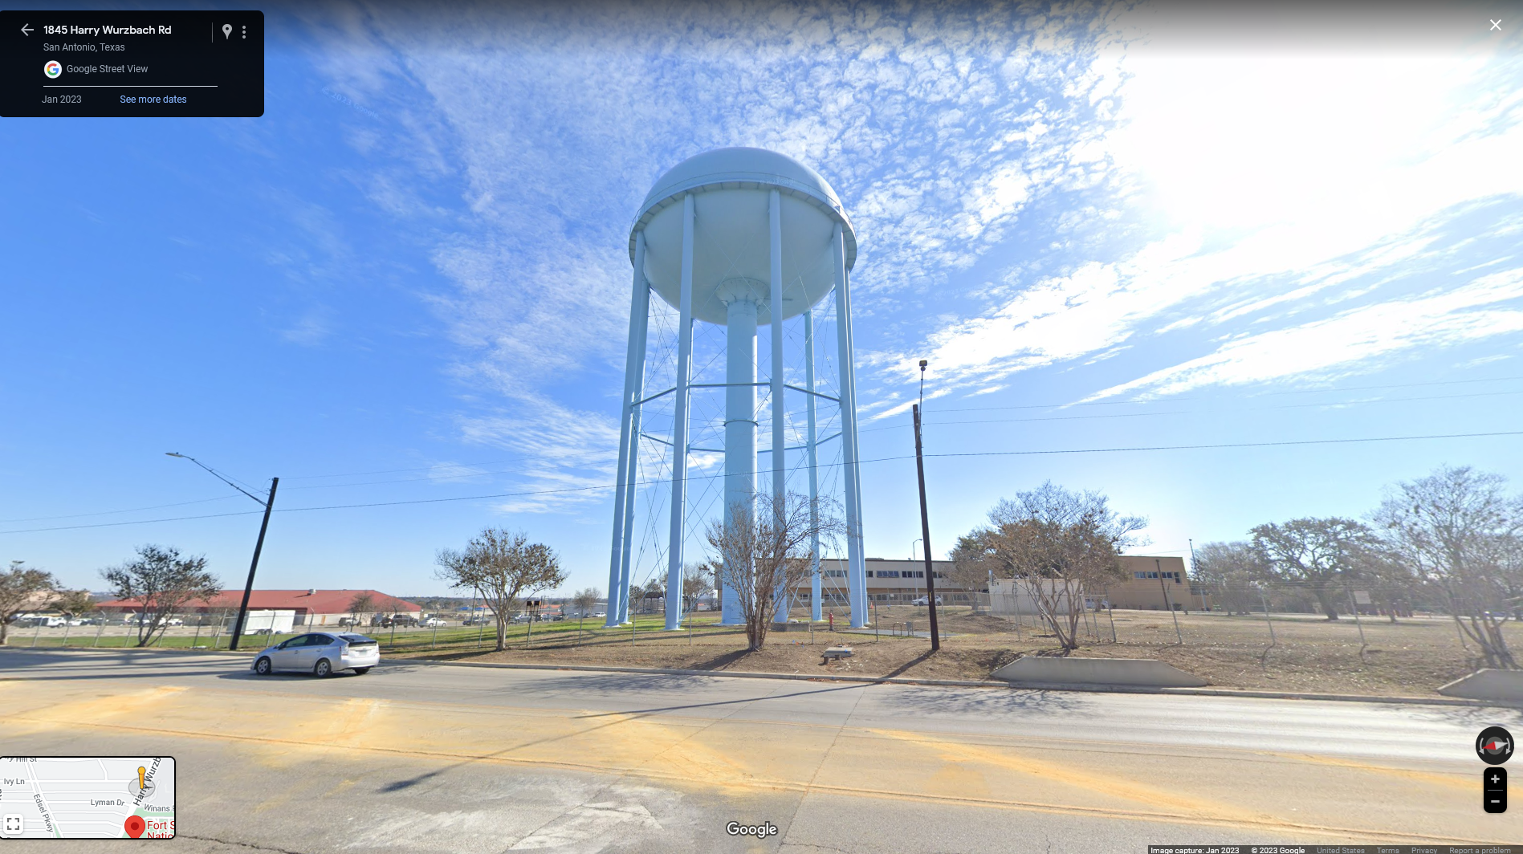
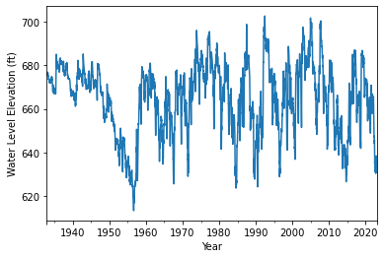
J-17 Well
Latitude 29.4792893
Longitude -98.4324544
https://www.edwardsaquifer.org/science-maps/aquifer-data/historical-data/
Source of the Image is Google Maps StreetView @2023
Notes:
874 feet

Slide 3
Long Short-Term Memory (LSTM) Network
Recurrent Neural Network able to handle sequence of occurrence.
Can capture pattern in time series data.
Make Prediction for future trend.
Long term memory
Conveyor Belt where information can be added or removed over time
Short-term Memory
Working Memory updated very frequently
No. of neuron time-lagged-inputs controls the short-term memory of the model.

Slide 4
Temporally Ordered Splitting
Train, Validation and Test Split.
Split maintains the temporal ordering
Model is never trained on data from the future.
Model is only tested on data from the future.
Training Data: 80% Data (1932 - 11 - 12 to 2004 - 11 -13)
Validation Data: 10% Data (2004 - 11 -13 to 2014 - 02 - 14)
Testing Split: 10% Data (2014 - 02 - 14 to 2023 - 03 - 02)
Notes:
The train/validation/test data must be split in such a way as to respect the temporal ordering and the model is never trained on data from the future and only tested on data from the future.

Slide 5
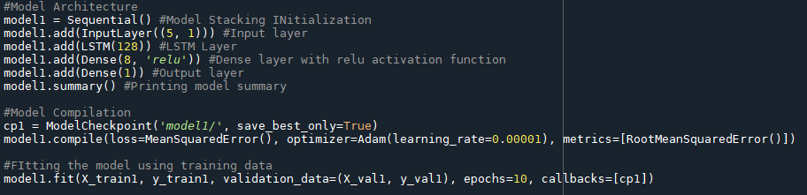
Model Architecture
Endogenous Model - Only considers past values of same variable as input.
10 day rolling average is used.
No external variables.
Input Layer set as number of lag values sent (i.e.. 5)
1 LSTM model with 128 neurons.
Dense Layer with 8 neuron and RELU activation function.
1 neuron output layer.

Slide 6
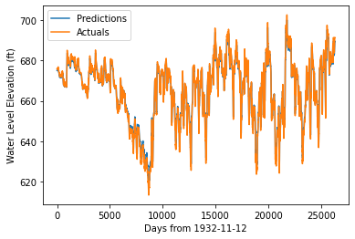
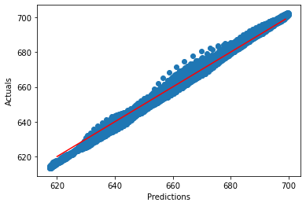
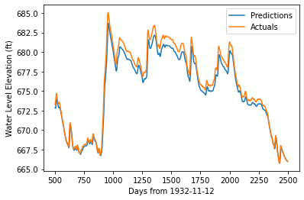
Results – Training Data
RMSE = 1.467

Slide 7
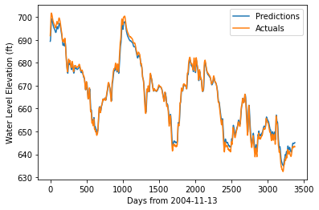
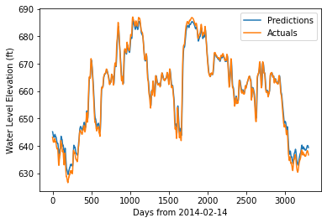
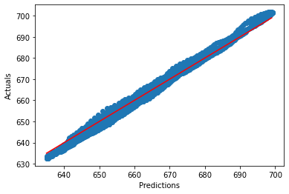
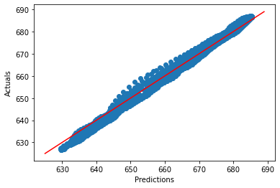
Validation Data
Testing Data
RMSE = 1.553
RMSE = 1.663

Slide 8
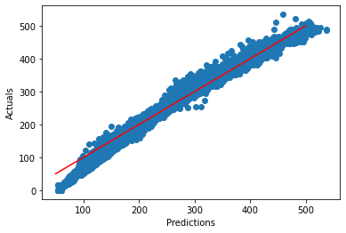
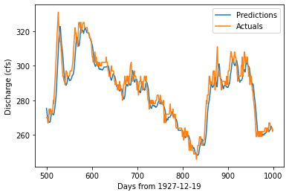
Comal Springs Flow
1927-12-19 to 2023-04-16
80-10-10 Train-Validation-Test Split.
Same model Architecture
RMSE = 11.218

Slide 9
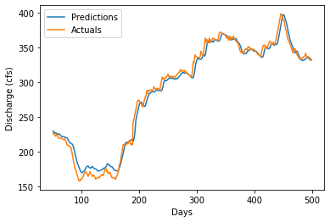
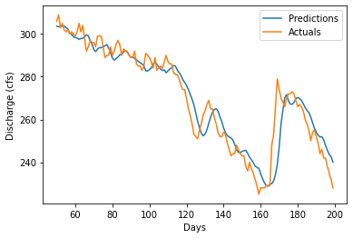
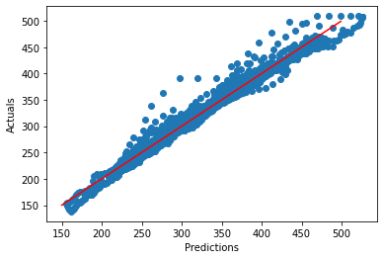
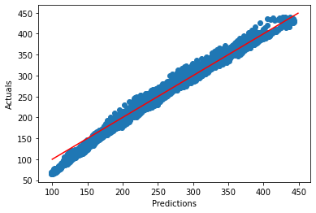
Validation Data
Comal Springs
Testing Data
RMSE = 8.921
RMSE = 10.56

Slide 10
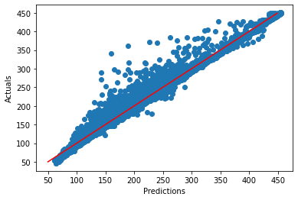
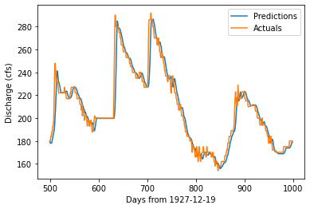
San Marcos Flow
1956-05-26 to 2023-04-10
80-10-10 Train-Validation-Test Split.
Same model Architecture
RMSE = 8.476

Slide 11
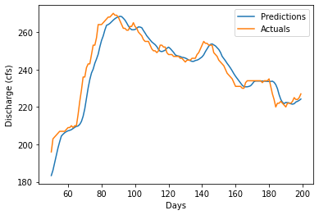
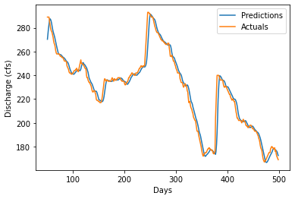
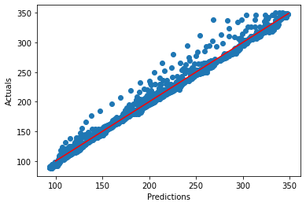
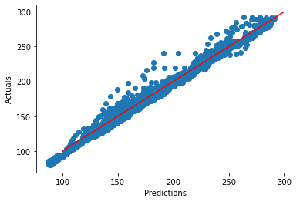
Validation Data
San Marcos Springs
Testing Data
RMSE = 6.498
RMSE = 5.577
577

Slide 12
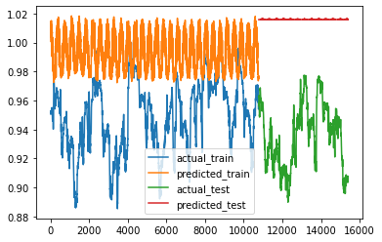
Exogenous Model
Input variables are Temperature and Rolling-Sum of Precipitation
5 Lags of each variable
Other Model Architecture are same.

Slide 13
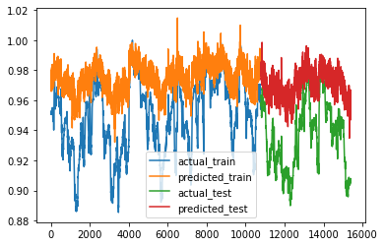
Exogenous Model
Input variables are Temperature and Rolling-Sum of Precipitation and Water Level Elevation.
5 Lags of each variable
Other Model Architecture are same.
Captures the trend.

Slide 14
Summary
Use of LSTM model with Sequential TensorFlow requires specific format of Train/Test Data.
Without the lagging input of same variable, LSTM model doesn’t perform well.
Endogenous Mode’s Predicted-Actual plot very close to x=y line for all data splits.
Exogenous with ‘Water Level Elevation’ as input variable able to capture the trend.

